Slide 1
Meeting 9 March 2023

Slide 2
























PGM so far – Fleeing from Local Minima on Big Loops (Gaps)
BEFORE
TRY1 – Matrix Mul + cnn: Force to focus in more important regions
TRY2 – Matrix Mul + cnn + upsampling: Same goal as TRY1
$$x$$
$$x$$
$$x$$
$$𝒯_{γ}^{−1}\left(x\right)$$
$$𝒯_{γ}^{−1}\left(x\right)$$
$$𝒯_{γ}^{−1}\left(x\right)$$
$$z_{1}$$
$$z_{2}$$
$$z_{2}$$
$$z_{2}$$
Pretrained
$$z_{1}$$
$$ψ$$
Pretrained
$$γ$$
Pretrained
$$γ$$
$$\tilde{x}$$
$$\tilde{x}$$
$$\tilde{x}$$
$$γ$$
$𝒯_{γ}$ $\left(\tilde{x} \right)$
$𝒯_{γ}$ $\left(\tilde{x} \right)$
$𝒯_{γ}$ $\left(\tilde{x} \right)$
$$\overline{x}$$
$$\overline{x}$$
$$\overline{x}$$

Slide 3




Feature Extractor por infering $γ$
$$x$$
Matrix Mul
$$γ$$
$$z_{2}$$
MC Sampling
(100 iters)
Pretrained
$$\tilde{x}$$
CNN: (c_in:39, c_out: 10, kernel: 14) + LeakyRelu(0.5)
Linear: (in: L_upsamp, out: tess cells)
CNN: (c_in:10, c_out: 5, kernel: 14) + LeakyRelu(0.5)
Upsampling-deconv: (c_in:15, c_out: 28, kernel: 30) + LeakyRelu(0.5)
Upsampling-deconv: (c_in:5, c_out: 15, kernel: 30) + LeakyRelu(0.5)

Slide 4
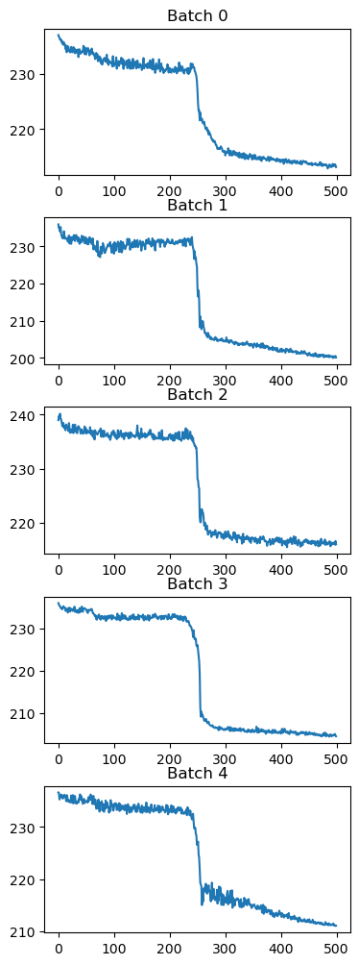
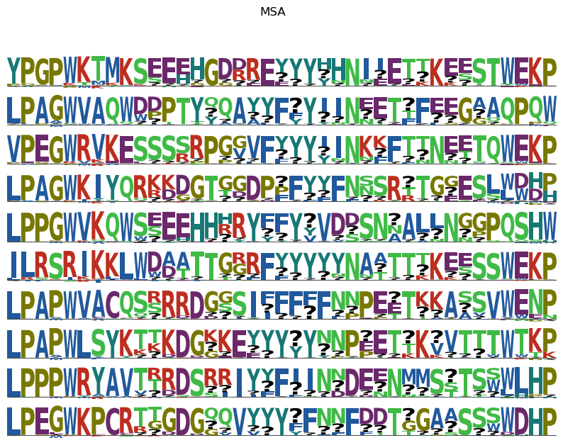

Slide 5
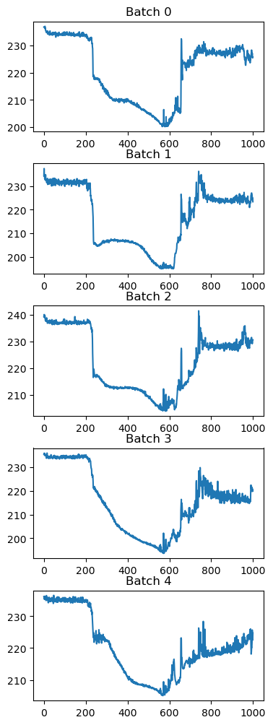
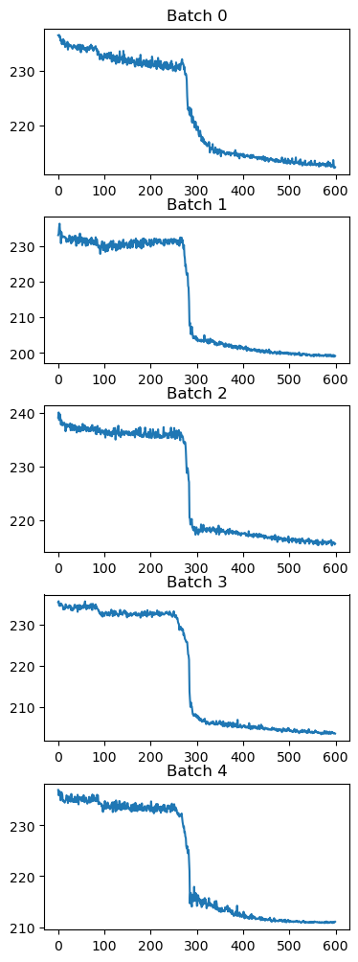
500 iters, slope:0.5
1000 iters, slope:0.5
600 iters, slope:0.1
1000 iters, slope:0.1
RUNNING!!! (see reproducible result)

Slide 6
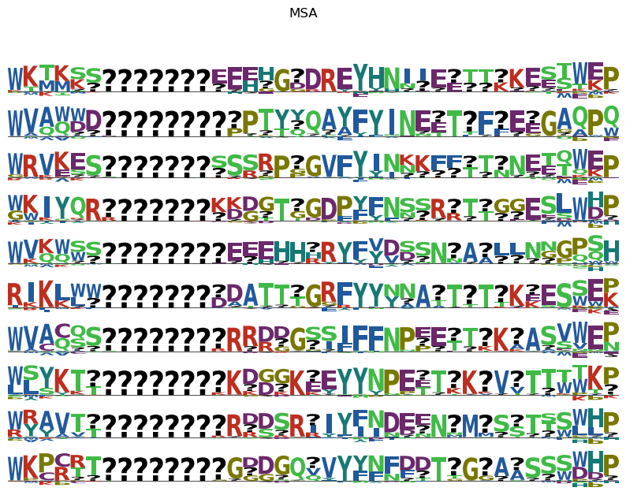

Slide 7
NEW ARCHITECTURE

Slide 8
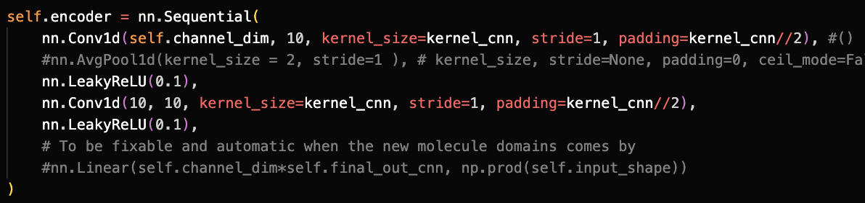
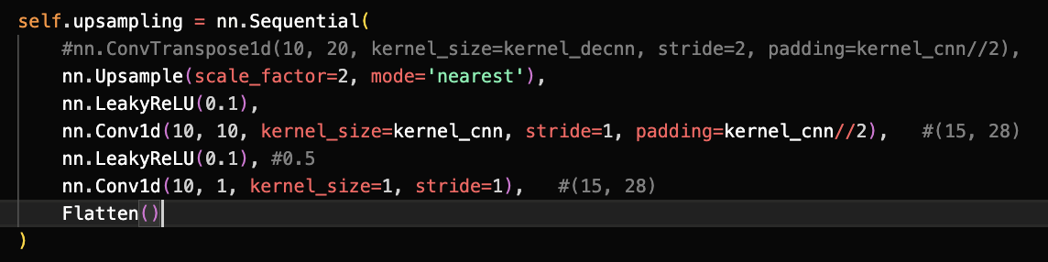
Feature Extractor por infering $γ$
$$x$$
Matrix Mul
$$γ$$
$$z_{2}$$
MC Sampling
(100 iters)
Pretrained
$$\tilde{x}$$

Slide 9
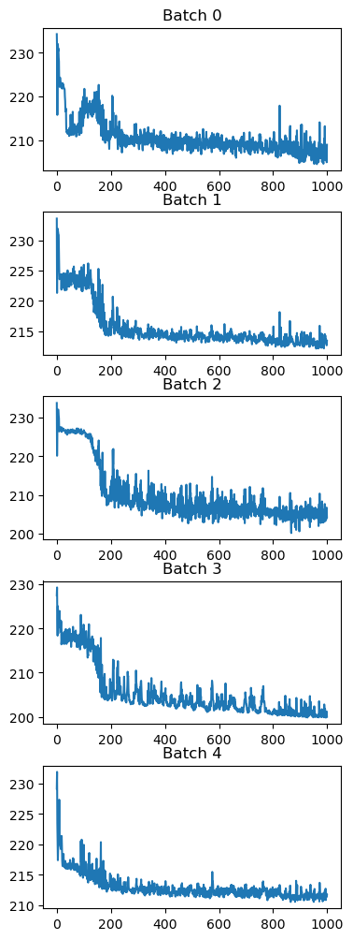
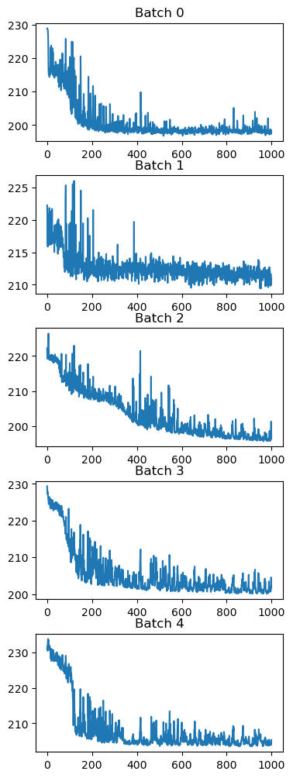
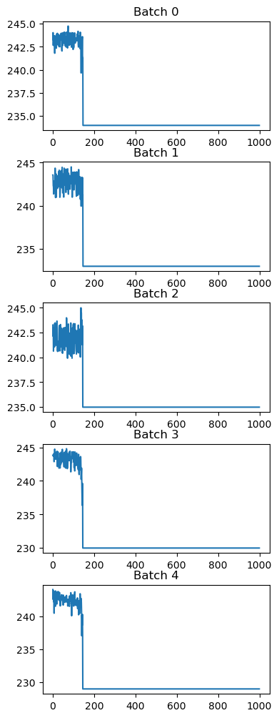
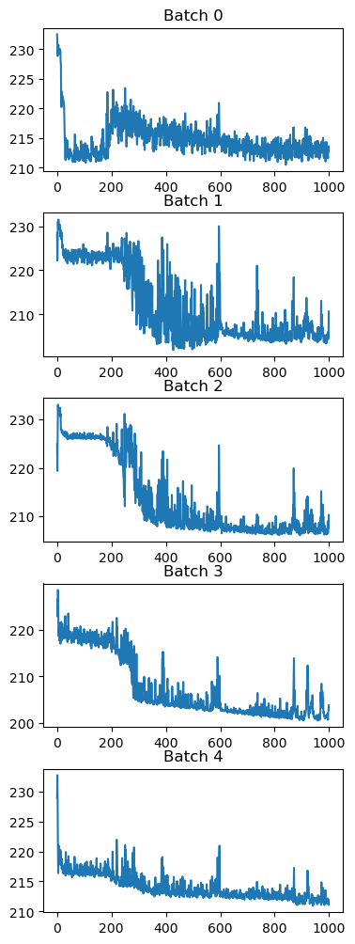
LR=1E-3, cnn-UPSAMPLING, kernel_size= 11
LR=1E-3, cnn-UPSAMPLING, kernel_size= 15
Nearest
Linear
Nearest
Linear

Slide 10
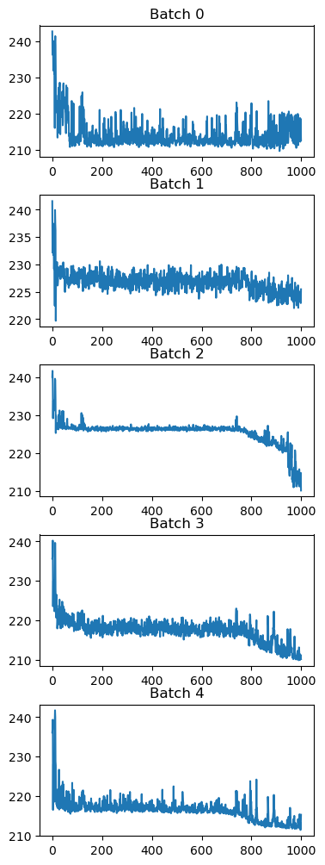
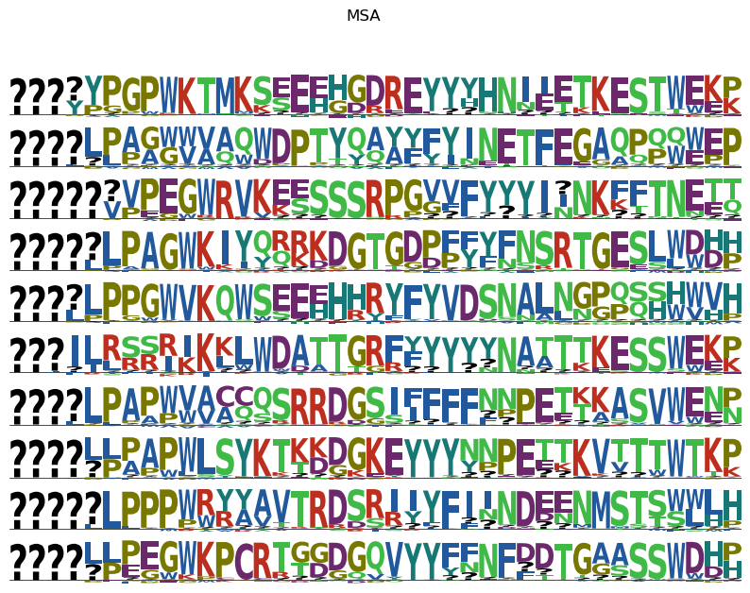
Is something happening here?, why is it going down after iter 800?

Slide 11
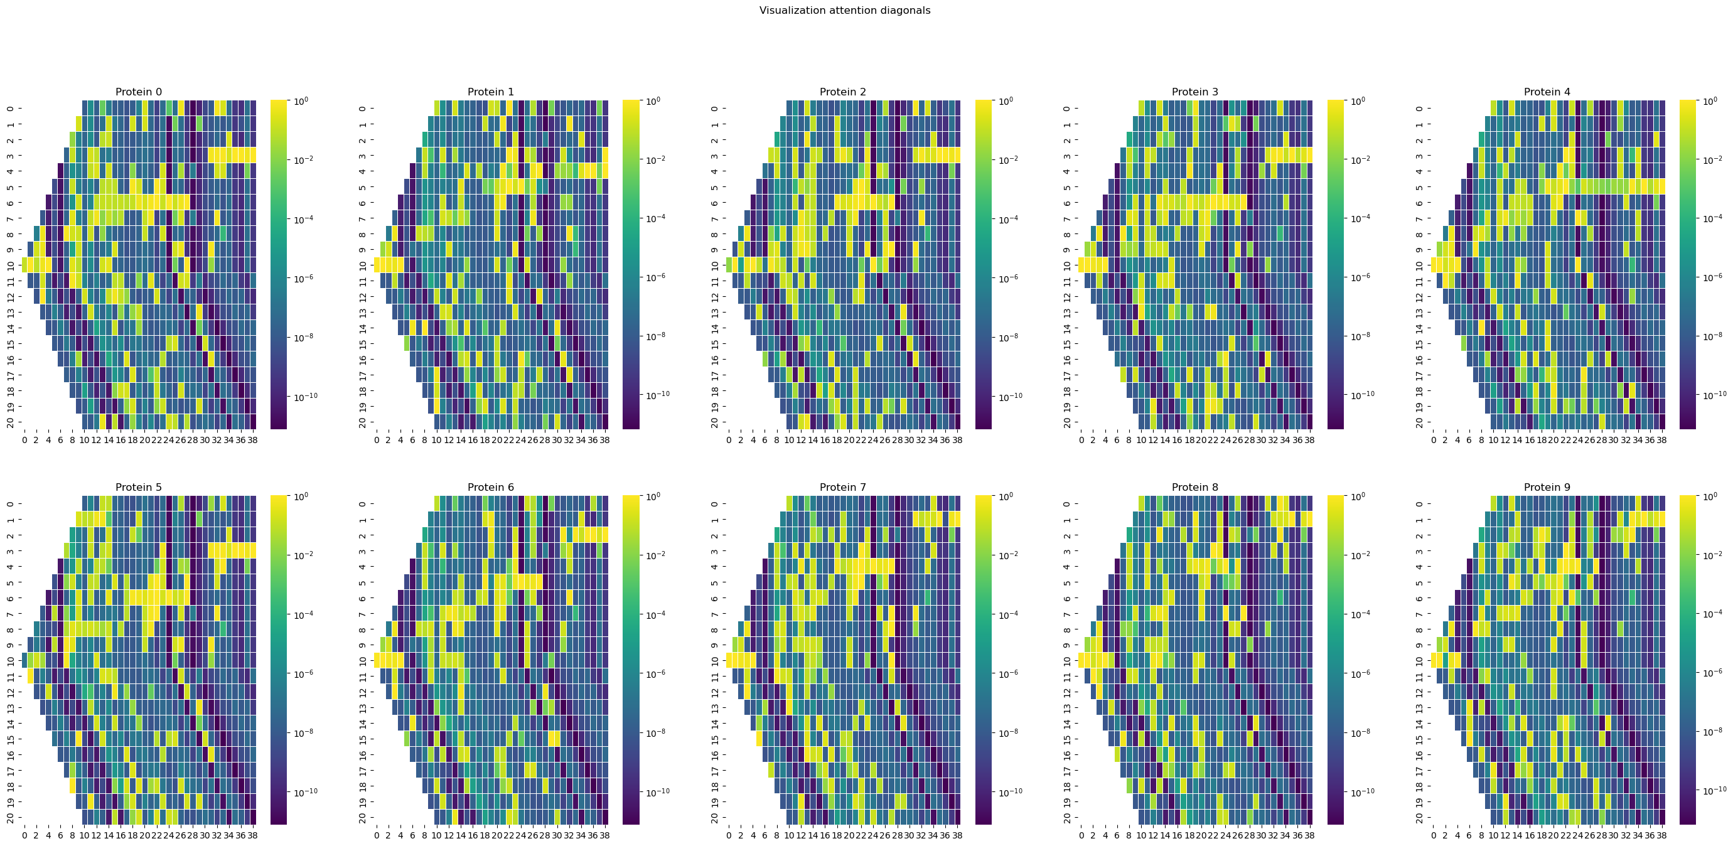
BEFORE – MULTIPLICATION( RAW DEEP, SEQUENCE => PRETRAINED WITH 10 SEQUENCE)

Slide 12
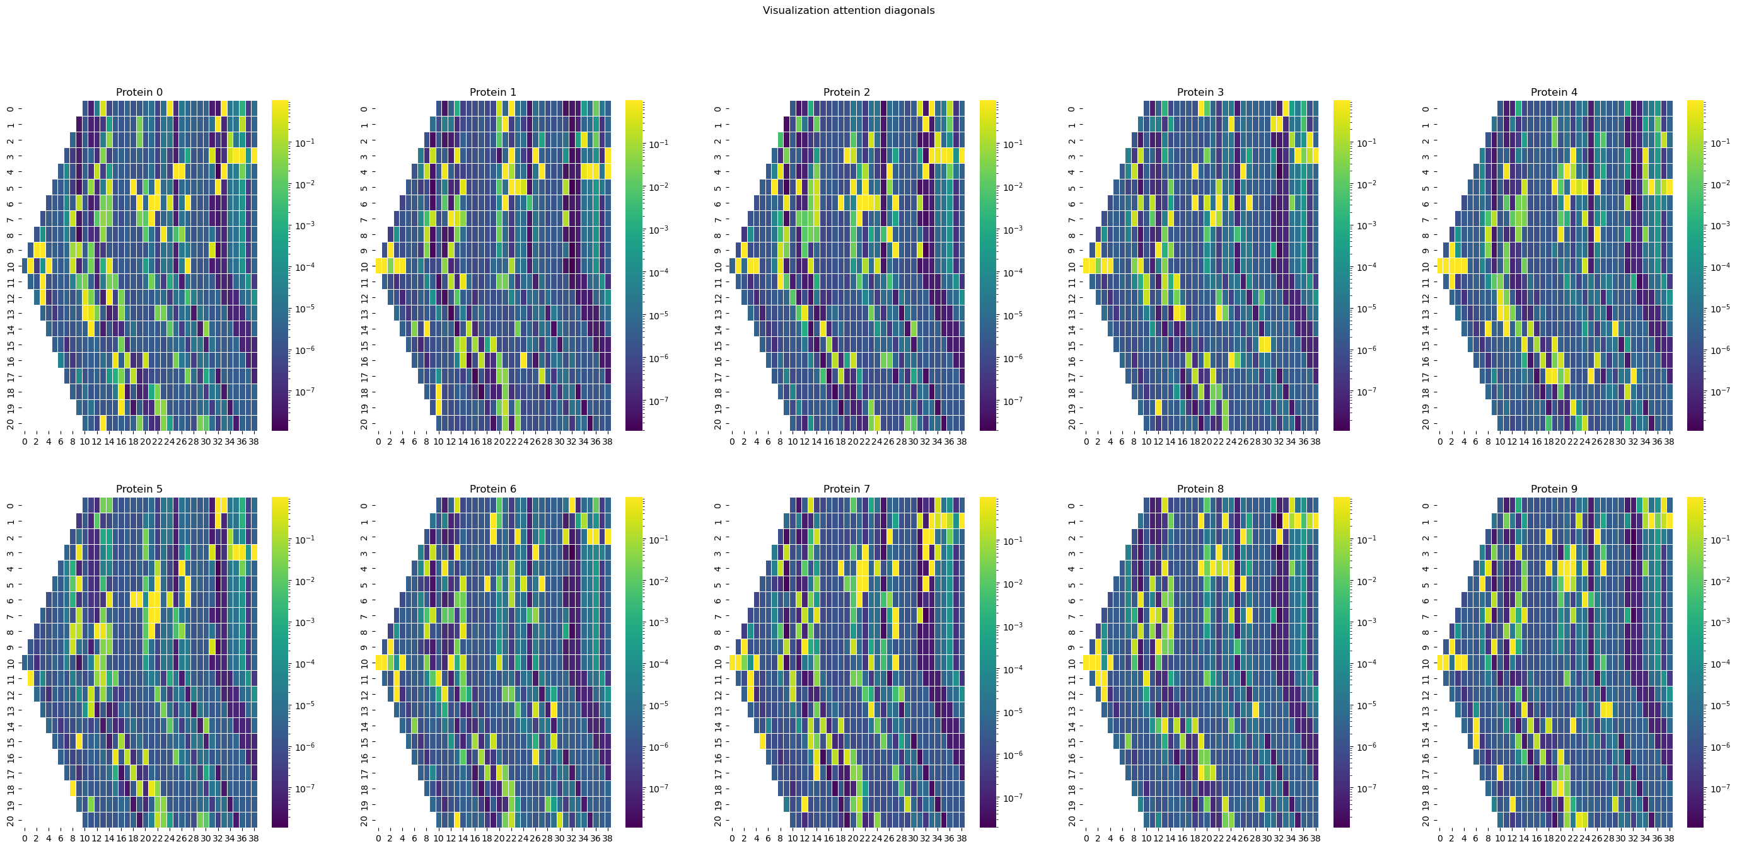
BEFORE – MULTIPLICATION( RAW DEEP, SEQUENCE => PRETRAINED WITH 100 SEQUENCE)

Slide 13
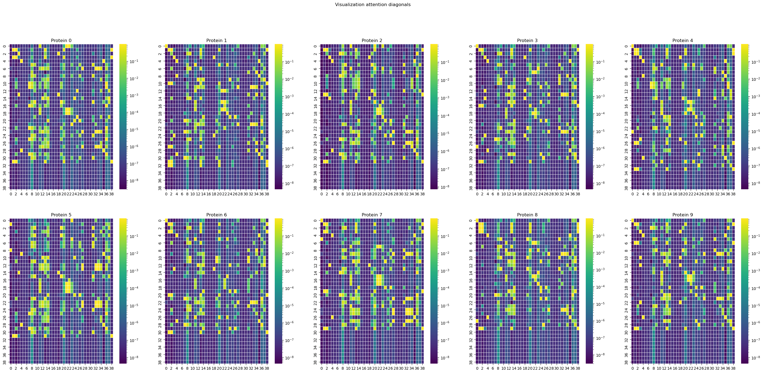

Slide 14
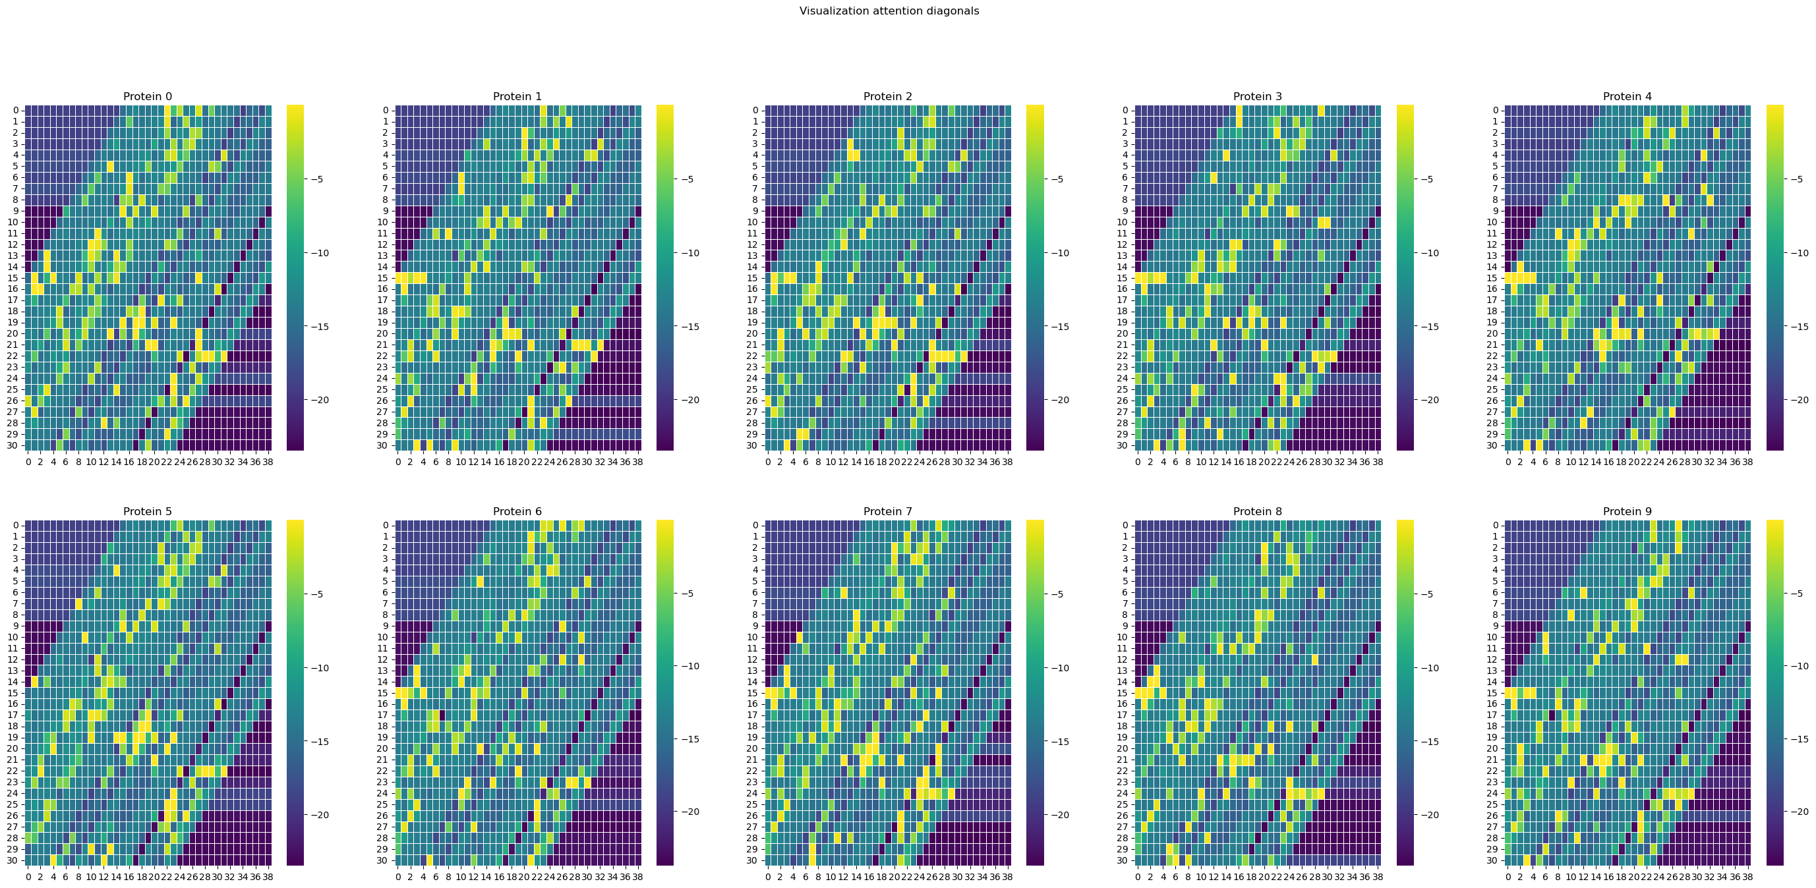
SO FAR – 24 March 2023

Slide 15
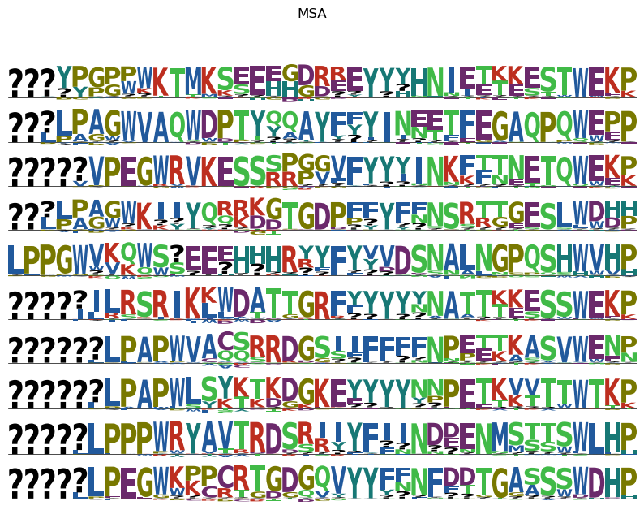
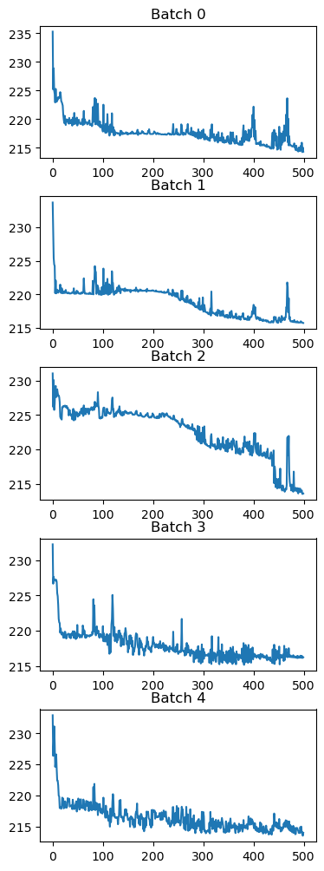

Slide 16
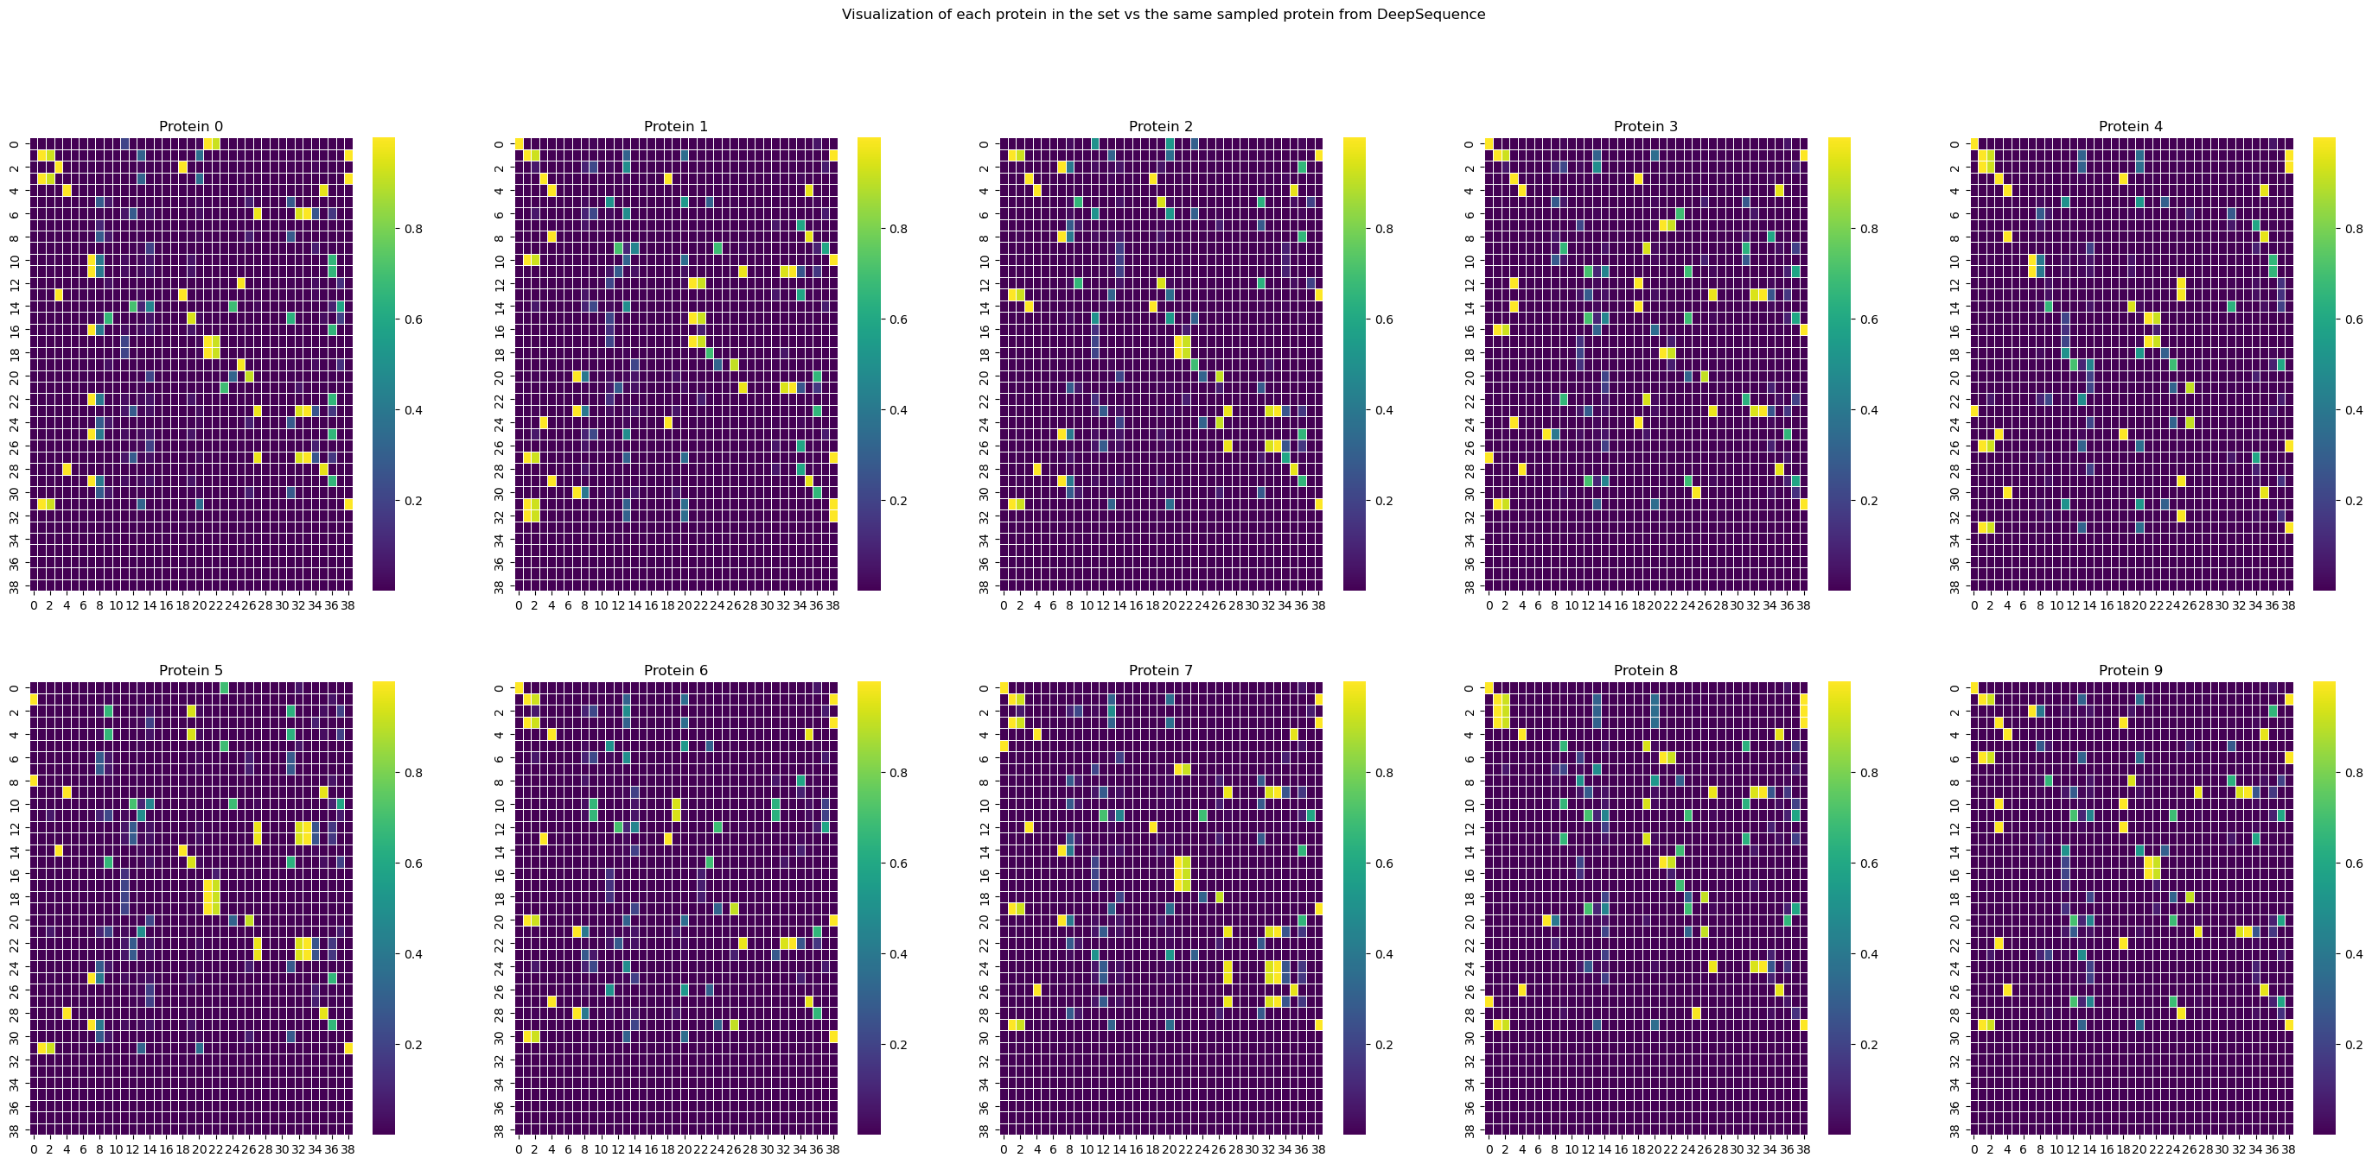
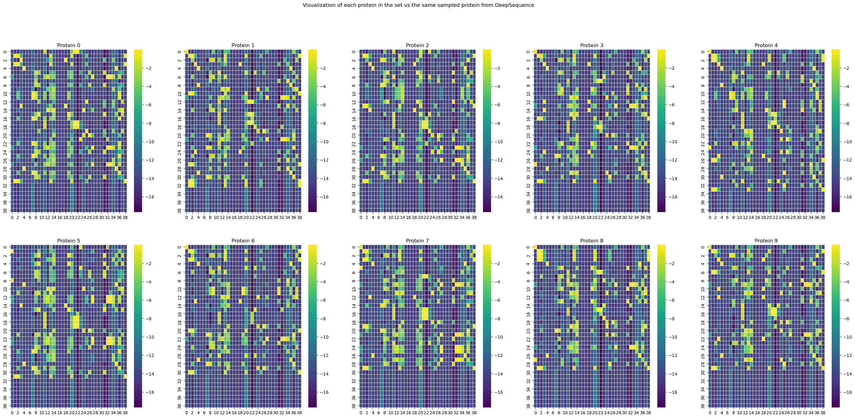

Slide 17
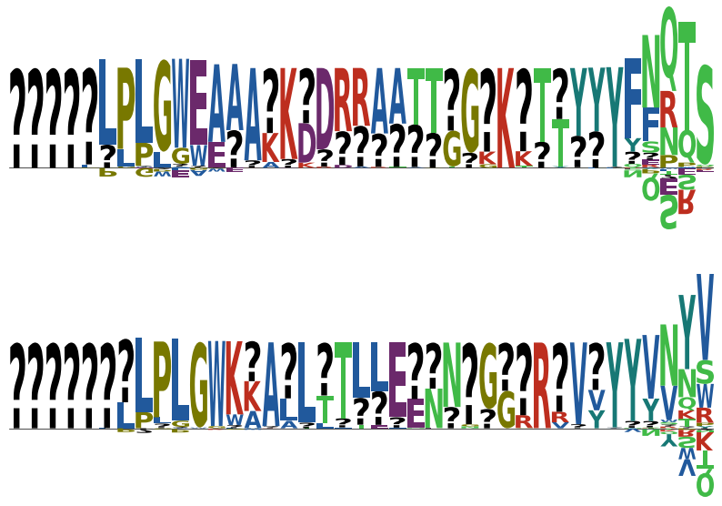
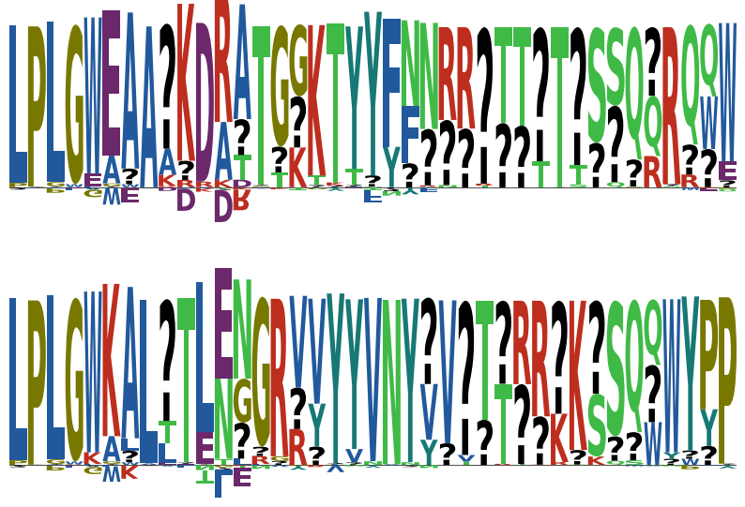
WITH NETWORK INITIALIZED AS DEFAULT (THETA OUTPUT NN)
WITH NETWORK INITIALIZED IN ZERO (THETA OUTPUT NN)

Slide 18
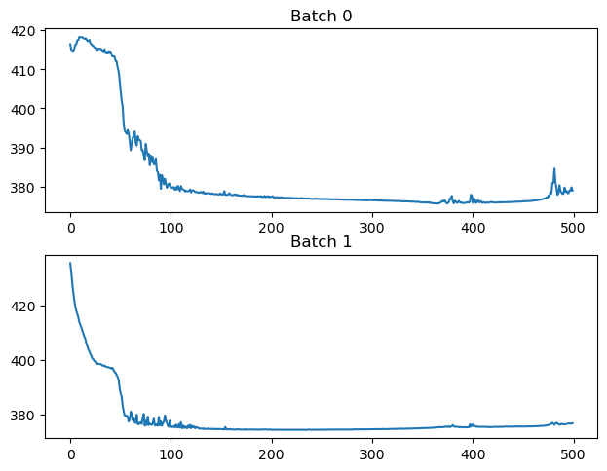
Prior definition over weights
So far it is working by setting up the wights in zero
Not sure how healthy would be to do that (risk of exploding gradients?)
Trying normal distributions:
N(0, 1e-3) and N(0, 1e-4): Colapse
N(0, 1e-5)
N(0, 1e-6)
WORKS!!!

